Slide 1
Concepts of MVA

Slide 2
Terminology
Model form
Elasticity
Weights
DME
Due-to
Contribution
Second Stage
Pooled
Bayesian Shrinkage
Synergy
Bayesian Priors
p-value
Decomps (Removal approach)
Impressions vs. GRPs
Retail vs. Shipments
Diminishing returns
Saturation
Response Curves
Long Term
Simulations
Effectiveness/Efficiency/ROI
GP/UC
Temp Norm/Normalized
Price Index
Own Price vs. All Price change
Log / Double log
445/Consumption days
Category headwinds
Difference vs. Level Models
C vs S
Flighting
Notes:
<AK>

Slide 3
Model form
Log (Volume)
ParVal1*driver1 + ParVal2*driver2 + etc
% Chg Vol
Exp(ParVal1*driver1 + ParVal2*driver2 + etc)
% Chg Vol
Volume2/Volume1 - 1
% Chg Vol
Exp(A)/Exp(B) -1 = Exp(A-B)- 1
% Chg Vol Due To Temperatuer Change
Exp(ParValTem0*(temperature chg) + ParValTem1*(temperature change)*norm normalized) -1

Slide 4
Functions
Log / LN
Exp
Power
Negative Exponential

Slide 5
Model Criteria
Face validity criteria are
Statistical validity criteria are
Data transformations based on mental models and adhering to global best practices
Correct signs on coefficients
Elasticities or volume response rates within reasonable ranges
Interactions and competitive effects within reasonable ranges
Volume contributions within reasonable ranges
Change to year ago due to errors of reasonable size
Change to year ago due to effect sizes sensible
Minimal use of dummy variables and trend terms
Low MAPES
High R2
Small bias
Alignment of predicted to actual, no odd jumps or 0s in predicted volume
High confidence in coefficients either via heavy reliance on Bayesian Priors or via high t-stats
Forecast accuracy
The statistical criteria are necessary, but not sufficient for model quality. When not all criteria can be met, face validity is valued over statistical validity

Slide 6
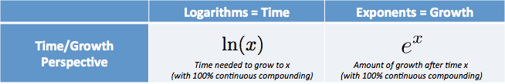
E-L
The natural log gives you the time needed to reach a certain level of growth.
The number e is a mathematical constant, approximately equal to 2.71828
the logarithm of a number is the exponent to which another fixed number, the base, must be raised to produce that number
The Rule of 72

Slide 7
Functional form for temperature in most MVAs: difference from norm with differential summer vs. winter effect
% change in volume if temperature is +1°C warmer
Double click on chart, enter different temperature norm or parameter values
Source: WT360 for temperature data, MVA models for elasticity

Slide 8
Temperature data transformations tried in MVA
Transformations tried in MVA | Illustration: for +1°C | Positive slope across range of temperatures? | Effect never veers off to + or - infinity | Not confounded with seasonality? | Bigger effect in warmer months? | Parsimonious and Linearizable? | Positive slope across range of temperatures?
Most common: difference from fixed norm with differential effect depending on starting temp. beta*(Temp–Norm) + beta*(Temp-Norm)*(Temp-NormNormalized); some countries also have lag1 week effects |  | ✓ | ✓ | ✓ | ✓ | ✓ | ✓
Log Temperature |  |  |  |  |  | ✓ | 
Difference from norm |  | ✓ | ✓ | ✓ |  | ✓ | ✓
Ratio to Norm, with threshold |  | ✓ | ✓ | ✓ |  | ✓ | ✓
S-shaped |  | ✓ | ✓ | ✓ | ✓ |  | ✓
% chg vol
-40 0 35
Starting temperature

Slide 9
Five different functional forms for precipitation are employed in today’s MVAs
France
beta*(Precip – Norm) + beta*(Precip-Norm)*(NNormalized)
Double click on chart, enter different temperature norm or parameter values
Nigeria
beta*(Precip – Norm) +
beta*(Precip-Norm)*(1-NNormalized)
China
beta*(Precip – Norm)
Colombia
beta*(Precip )
Italy
beta*(Precip – Norm) + beta*(Precip-Norm)*(SummerTime)
Source: WT360 for temperature data, MVA models for elasticity

Slide 10
Precipitation data transformations tried in MVA
Transformations tried in MVA | % chg vol for +1 mm per day | Negative vol for more precip | Effect never veers off to + or - infinity | Not confounded with seasonality? | Bigger effect in drier or wetter months? | Parsimonious and Linearizable? | Countries using this functional form
Straight precip |  | ✓ | ✓ |  |  | ✓ | COL, ECU, EGY, KOR, MYS, MAR all Products, SNG, ROM, TUR, VNM
Difference from norm1 beta*(Precip – Norm) |  | ✓ | ✓ | ✓ |  | ✓ | CHN, IND, IDN, MAR Coke, PHL
Difference from norm2 beta*(Precip – Norm) + beta*(Precip-Norm)*(NormNormalized) |  | ✓ | ✓ | ✓ | wetter | ✓ | FRA(+ lag), GBR (+ lag), MEX, PAK, CHE, THA
Diff from Norm 3: beta*(Precip – Norm) + beta*(Precip-Norm)*(1-NormNormalized) |  | ✓ | ✓ | ✓ | drier | ✓ | Kenya, Nigeria, Tanzania, Uganda
Diff from norm4 with additional effect during summer, summer defined by indicator variable, value of 0 or 1 |  | ✓ | ✓ | ✓ |  | ✓ | Italy
Humidity Diff from Norm2 |  | ✓ | ✓ | ✓ | More humid | ✓ | Peru
% chg vol
0 10
Starting Precip

Slide 11
Of candidate drivers considered, the best appear to be: GDP or Industrial Production, plus population 12-49
Economy Driver | Commentary | Periodicity available | R2 with Industry Unit Cases, 2002 forward | R2 with TCCC Unit Cases, 1993 to 2015 | Expected Elasticity of TCCC sales to driver
Disposable Income | Conceptually the best metric, representing well “cash in people’s pockets.” | Annual | 0.4% | 0.1% | 0.6 to 1.0
PCE | Private Consumption Expenditure. Global standard today. But it is “bouncy” in China, relative to GDP | Quarterly | 0.0%, wrong sign | 0.6%, wrong sign | 0.6 to 1.0
GDP | Global MVA standard back up to PCE. Economists frequently question the validity of GDP and by extension PCE also | Quarterly | 56.6% | 32.4% | 0.6 to 1.0
Retail Sales | A component of PCE. Retail good + services = PCE. Works well for MVA Australia. | Monthly | 11.0% | 5.0% | 0.6 to 1.0
Industrial Production | A component of GDP. Economists seem to trust this metric more than GDP and when consultants make a new macro economy measure it typically considers this one. | Monthly | 44.5% | 30.9% | 0.6 to 1.0
Unemployment | Useful in 8 or 9 countries’ MVAs as a second metric in addition to a primary macro economy driver (typically PCE) | Monthly | 9.4% | 2.8% | -0.1 to -0.3
Population P12-49 | Our target consumer and the audience is shrinking. | Annual | 18% | 34% | ~1

Slide 12
[ ]
Driver | Functional form with some suggested Bayesian Prior
Temperature | β∗(Temp - norm) + β∗(Temp_t-1 – norm_t-1) +β∗(Temp - norm) ∗norm_normalized + β∗(Temp_t-1 – norm_t-1) ∗norm_normalized
Precipitation | β∗(Precip per day - norm) + β∗(Precip per day _t-1 – norm_t-1) +β∗(Precip per day - norm) ∗(1-norm_normalized) + β∗(Precip per day _t-1 – norm_t-1) ∗ (1-norm_normalized)
PCE | 1.0∗ln(PCE)
Unemployment | -0.2∗(UnemploymentRate/100)
Tourists | 0.13∗ln(#Tourists)
Quarterly and monthly data series need to be interpolated to apply to weeks. Simple interpolation is desired over Spline interpolations.

Slide 13
Most MVA models for TCCC have a structure like this for execution drivers, with all-channels, brand granularity on the output
Ln(unit case volume) = β∗Ln(Store Universe)
+ β∗WtCh1∗WDCh1/100 + β∗WtCh2∗WDCh2/100 + …
+ β∗WtCh1∗Ln(1+LN(IPSCh2)) + β∗WtCh2∗ Ln(1+LN(IPSCh2)) + …
+ β∗WtCh1∗Ln(TranSizeCh1) + β∗WtCh2∗Ln(TransSizeCh2) + …
+ β∗WtCh1∗(FSSCh1 or SOVICh1) + β∗WtCh1∗(OOS) + β∗Ln(CoolerInventory)
+ β∗WtCh1∗WtCompet1 ∗ WDCompet1Ch1/100 + …
+ β∗WtCh1∗WtCompet1(1-exp(-0.5*IPSCompet1Ch1 - 1)) + …
+ β∗WtPack1Ch1∗Ln(PricePack1Ch1/CPI) + …
+ β∗WtPack1Ch1∗WtCompet1 ∗ Ln(PriceCompetPack1Ch1/PricePack1Ch1) + …
+ β∗WtPack1Ch1∗(RetailUnitCasesIncrPromoPack1Ch1/RetailUnitCasesTotalPack1Ch1)) + …
OR + β∗WtPack1Ch1∗DepthDiscountPack1Ch1
Dependent measure is brand all channels total country level, e.g. Coke China
βs are different #s of course; subscript notation left off for ease of illustration
WtCh1 = weight for channel1. Channels for China were: Modern Trade, General Trade, Town, Village
WD = weighted distribution, e.g. 80
… implies more similar terms for more channels
IPS = items per store = sum of WD across SKUs for brand divided by brand WD. 2 to 4 in GT; 5 to 10 in MT
TransSize = transaction size = WD weighted ml per pack. Note: final model also split this driver into pack groups 5-600ml, 2-2.5L
FSS = forward stock share, available only in General Trade channel
WtCompet typically set to min(1, compet/target brand volume)
Compet1 = competitor

Slide 14
Typical Execution drivers in models with brand level output
Assume 2 channels and 2 packs make up the total
Log(Unit Case Shipments) = other stuff
+ β * Wt_Channel1 * WD_Channel1/100 + β * Wt_Channel2 * WD_Channel2/100
+ β * Wt_Channel1 * IPS^_Channel1 + β * Wt_Channel2 * IPS^_Channel2
+ β * Wt_Channel1 * OOS_Channel1/100 + β * Wt_Channel2 * OOS_Channel2/100
+ β * Wt_Channel1 * SOVI_Channel1/100 + β * Wt_Channel2 * SOVI_Channel2/100
+ β * Wt_Channel1 * Wt_Pack1*ln(Price/CPI) + β * Wt_Channel1 * Wt_Pack2*ln(Price/CPI)
+ β * Wt_Channel2 * Wt_Pack1*ln(Price/CPI) + β * Wt_Channel2 * Wt_Pack2*ln(Price/CPI)
+ β * Wt_Ch1 * Wt_Pk1*WDPromo_Pk1*Disc^ + β * Wt_Ch1 * Wt_Pk2*WDPromo_Pk2*Disc^
+ β * Wt_Ch1 * Wt_Pk1*WDPromo_Pk1*Disc^ + β * Wt_Ch1 * Wt_Pk2*WDPromo_Pk2*Disc^
- OR -
+ β * Wt_Ch1 * Wt_Pk1*(Retail Promo Vol/ Retail Tot vol) + β * Wt_Ch1 * Wt_Pk2*(Promo/Tot Vol)
+ β * Wt_Ch1 * Wt_Pk1*WDPromo_Pk1*Discount + β * Wt_Ch1 * Wt_Pk2*WDPromo_Pk2*Discount
Wt = weight. Ideally weights sum to 1.00 and will be based on ship volume.
Channel weights sum to less than 1.00 if channels with this sort of data do not sum to total shipments.
If OOS or SOVI are available in only 1 channel, do remember to use the weight of that 1 channel in the computation
Pack weights usually do sum to 1.00. Even if not all packs are included in the model structure, we put packs that make a majority of the volume and assume they represent the total and make the weights sum to 1.00
^ transformations explored on following pages
Width: Weighted Distribution, % outlets | Distribution | 2 Execution
Depth: items per Store
Quality: out of stock, location in outlet
Retail Price, CPI adjusted | Price
Promoted price, depth of discount | In-Outlet Promo
Displays, Flyers, promoters

Slide 15
Double-log transformation on IPS gives steep diminishing returns
% Lift in volume for +1 IPS from starting level
India CBO Territory: current best practice model formulation and insight presentation format
Ln(1+ln(IPS))
This formulation makes sense if brand level volume is the granularity of the dependent measure.
What might we expect when pack group is the granularity? Similar shape but lower starting level?

Slide 16
Best IPS data transformation: Negative exponential or double log
IPS Data Transformation Options
Log-log: ln(unit cases) = β*ln(IPS) + other stuff
Problem: not steep enough at low starting levels of IPS
But. . . If IPS is 10 or more for all time periods, choice of data transformation doesn’t matter
Negative exponential: ln(unit cases) = β*(1-Exp(-λ(IPS-1)) ) + other stuff
Solve β in the model.
λ today is set to 0.5 in several markets; not sure this is ideal, maybe should be higher to give higher result at ips starting level 2
Double log: ln(unit cases) = β*log( δ + α*log(IPS)) - β*log(γ)+ other stuff
Solve β in the model.
λ and γ today are set to ? And ? In one market where implemented so far
Β*α <= γ
Coke Italy Discounters
2.1 to 3.5
Coke Italy HyperSuper
6.4 to 8.5
Coke Australia
FoodStores ~20

Slide 17
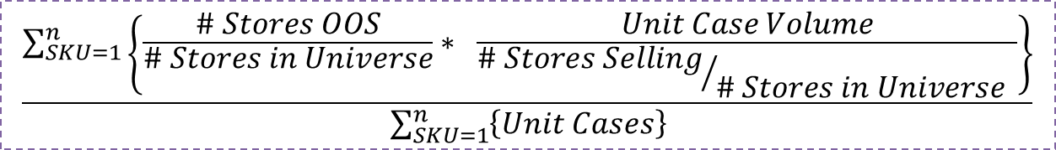
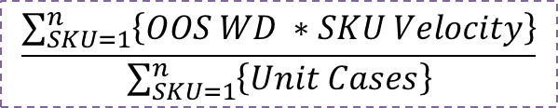
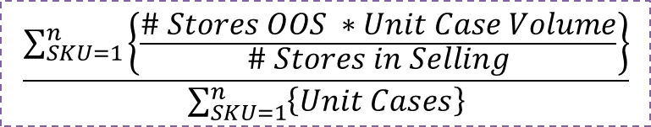
Use the global definition for out of stocks
Stated in OOS Companion Guide PPT form global commercial leadership
Define velocity of SKU as Nielsen unit case volume / WD
For ease of notation we will represent WD as (# Stores Selling / # Stores) in Universe; In reality each store counts not with a weight of 1.0 but with a weight commensurate with it’s contribution to Category or NARTD or ACV sales in the universe
Get OOS WD of each SKU
Multiply OOS WD of each SKU by velocity
Add #3 across SKUs
Divide by volume sum across SKUs
$$\frac{\sum_{SKU=1}^{n}{\left\{OOS WD ∗SKU Velocity\right\}}}{\sum_{SKU=1}^{n}{\left\{Unit Cases\right\}}}$$
$$\frac{\sum_{SKU=1}^{n}{\left\{\frac{\# Stores OOS}{\# Stores in Universe}∗ \frac{Unit Case Volume}{{\# Stores Selling}/{\# Stores in Universe} }\right\}}}{\sum_{SKU=1}^{n}{\left\{Unit Cases\right\}}}$$
$$\frac{\sum_{SKU=1}^{n}{\left\{\frac{\# Stores OOS ∗Unit Case Volume}{\# Stores in Selling}\right\}}}{\sum_{SKU=1}^{n}{\left\{Unit Cases\right\}}}$$
Essentially volume-weighted across SKUs, out of stocks as a % of stores selling.

Slide 18
Depth of discount driver: preferred transformation has accelerating volume lift for deeper discounts, up to a saturation level
Depth of Discount Data Transformation Options
This linear one was used in last year’s Italy model, coefs varied by pack, averaging 1.74
Recommendation: Ask local team if they have a Nielsen price & promo model done in within the past 5 years. Depth of discount elasticities tend not to vary much over time and previous study could give Bayesian prior for new model.

Slide 19




Price elasticities could be reported in this way
% Lift in volume for -1% Price
Only Own Price Change
Only TCCC Price Change
All Price Change
Elasticities when:
All Price Change
Only TCCC Price Change
Only Own Price Change
Coke Regular | Coke Light | Coke Zero | Fanta
-0.54 | -0.76 | -0.71 | -0.72
-1.18 | -1.04 | -1.15 | -1.37
-1.54 | -1.68 | -1.62 | -2.05

Slide 20
Reach curves can inform MVA adstock calculation: Ask Italy TCCC for them
Negative exponential with r value of 0.42

Slide 21
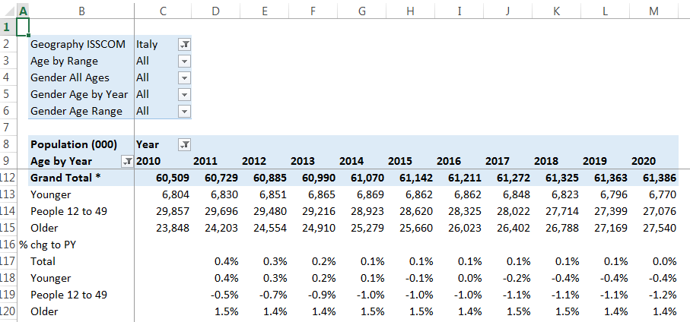
What goes into an MVA model when we don’t have GRPs?
Metric | Use in MVA, past model formulation
Spend, e.g. cinema in Italy | β1∗(1-r^(Adstock(spend/cost_per_tv_GRP)/100) ) Cost per TV GRP should be chosen carefully after considering alternatives, e.g. 1 figure for 5 years, 1 figure by year-brand.
Impressions, e.g. digital in Italy | β1∗(1-r^(Adstock(Impressions*100/Universe)/100) )
What universe? P12-49 seems appropriate because the aim is to get digital impressions on something close to the same scale as TV.

Slide 22
Today’s MVA formulation looks for volume impact for a very long time after sampling activity.
Coke Thailand Samples

Slide 23
Summary of outputs from various studies that can inform Mva Sampling coefficients and half lives
Study | Type of product | Short Term Coef | Short Term HL | Long Term Coef | Long Term half Life
TCCC surveys | Various, Europe | 0 to 0.6 conversion rates
Various | Various | .25 to 0.58 conversion rates
TCCC GB 2010, Purchase intent | Diet Coke |  |  |  | 21 weeks, purchase intent t2b
Heilman et al, 2005 | 6 products in diff categories | 0.6 conversion rate |  | 9.2 = wk 3to20/wk1to2 | 5 weeks
Knowledge Networks, 2009 | Line Ext |  |  | 7.8 = wk 3to20/wk1to2 | 6.4 weeks
 | New Prod |  |  | 11.6 = wk 3to20/wk1to2 | 8.1 weeks
 | Established Prod |  |  |  | 12.2 weeks
Bawa & Shoemaker, 2004 | Large share, 28% penetration |  | 2 weeks | 3.8 times ST | 19 weeks
 | Line Ext, 5% penetration |  | 2 weeks | 0.86 times ST | 12 weeks
Lawson et al, 1989 |  |  |  | Near 0 or negative
Average is 12

Slide 24
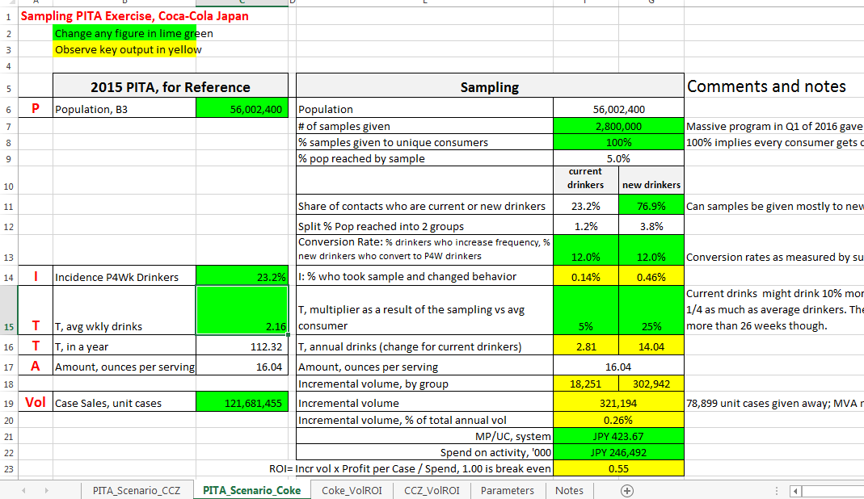
Use a PITA framework to check MVA Sampling volume uplift for face validity

Slide 25


Synergy is “baked in” to multiplicative volume form
 | People | * | Drinks Each | = | Total Drinks | Raw DueTo Bucket
Weekend 1 | 6 | * | 3 | = | 18
Weekend 2 | 8 | * | 4 | = | 32
Change | +2 |  | +1 |  |  | 32-18=14
Change DueTo # people | 8 | * | 3 | = | 24 | 24-18=6
Change DueTo # drinks per person | 6 | * | 4 | = | 24 | 24-18=6
Sum of raw DueTo buckets |  |  |  |  |  | 6+6=12
+2
+2
Log(volume) = beta1*covariate1 + beta1 * covariate2 + etc.
Volume = exp(beta1*covariate1) * exp(beta1 * covariate 2) * etc.
Synergy: 12 - 14 = 2

Slide 26
Multiplicative models have a synergy component to be managed when computing decomps and duetos
Here is an subtractive DueTo example:
 | Component A | * | Component B | * | Component C | = | Total Volume | Raw DueTo Bucket
Vol components, Period 1 | 30 | * | 2.2 | * | 1.15 | = | 75.9
Vol components, Period 2 | 28 | * | 2.5 | * | 1.7 | = | 119
Change: | -2 |  | 0.3 |  | 0.55 |  | 43.1
Change DueTo Base | 30 | * | 2.5 | * | 1.7 | = | 127.5 | -8.5
Change DueTo Trade | 28 | * | 2.2 | * | 1.7 | = | 104.72 | 14.3
Change DueTo TV | 28 | * | 2.5 | * | 1.15 | = | 80.5 | 38.5
 |  |  |  |  |  |  |  | 46.5
Synergy: 43.1 - 46.5 = -3.4

Slide 27
“Subtractive” approach to decomps and Duetos makes most sense at TCCC
Additive
Turn all marketing levers off. Volume estimate is base.
Turn marketing levers on, one at a time. Each time the simulated volume minus base is incremental from that activity.
Subtractive
Turn all marketing levers off. Volume estimate is base.
Turn marketing levers off, one at a time. Each time, total volume minus simulated volume is incremental volume from that activity.
Additive to base makes sense if you are mostly simulating “blank slate” scenarios
If I had complete freedom to spend marketing money on any activity in any market against any product, where should I put my first dollar? How should I allocate my total budget?
Subtractive makes sense if you are simulating mostly “adjustments from last year” scenarios
I have $x more to spend or to cut. Where should I allocate it?
I’m thinking of shifting money around between markets, but politically I cannot shift more than +/- 20%, how should I shift the money?
I recently took a price increase. How much more or less volume would I sell if my price had been the same as last year?
Consistency is important: better to pick one approach that fits most scenarios, and systematize or hard code the algorithm, than to swap back and forth and provide different answers to the same question over time.

Slide 28
Should we allocate synergy or leave it as its own slice of the pie?
Yes, of course we should allocate it!
Not allocating it begs the question. . . but if my marketing activity is contributing to that synergy, when I calculate an ROI, shouldn’t I give my marketing some credit for some portion of the synergy?
And. . .while most brand managers understand synergy on an intellectual level, having a synergy slice of the pie doesn’t help them with marketing decision making
And. . .it can be an uphill battle to try to explain synergy
And. . .some would argue that is as much an algebraic artifact of the model form as it is of “magic” of multiple marketing efforts simultaneously

Slide 29
Should we allocate synergy to only incremental, or incremental and base?
In a volume decomposition
Allocate synergy only to incremental volume if you believe the synergy is driven mostly by the magic of integrated and aligned marketing activities
This is the case at The Coca-Cola Company
Belief: for TCCC, we strive for integrated media messaging and for driving “marketing magic” synergistic effects
Allocate synergy to both base and incremental if you believe all components of the model contribute to the synergy effect and it is mostly a model artifact.
Base volume can be much higher in summer (index of 1.2), and on holidays (index of 1.5 or 2). More people are in the market, buying the category during these times.
In a DueTo
For TCCC, following similar logic, it makes the most sense to allocate synergy to only incremental drivers.

Slide 30
How should we allocate synergy?
Multiplicative: multiplying each Decomp raw bucket by the ratio of total volume change to the sum of the Decomp buckets
Why: simple, straightforward, first idea we typically have is to do it this way
Issue: Can flip signs in a DueTo and dramatically amplify size of bucket
Multiplicative with Like sign: only allocate synergy to raw buckets with same sign as synergy
Why: some would argue positive synergy is only being driven by positive marketing drivers
Issue: get a different answer if run the analysis at different levels of aggregation
Covariate Ratio
Why: avoid sign flipping of multiplicative methods and allocate some synergy to all buckets
Approach: allocate synergy by indexing raw Decomp buckets proportionally to the size of each “covariate”, i.e. each coefficient * data value component
Issue: largest slice changes most, more than it would with the absolute method
Absolute: proportional to the absolute value of the raw Decomp bucket
Why: Avoids multiplicative amplification problems. Minimizes sign flipping.
Issue: can get sign flipping on small drivers, but minimized with this approach
Issue with all methods: can get a different answer if run the analysis at different levels, e.g. total television versus by campaign, or quarters vs. weeks.
Absolute, Use Atomic, and allocating only to incremental drivers is all around best method for TCCC

Slide 31
Synergy example, proportional to absolute value of covariate
 | People | * | Drinks Each | = | Total Drinks | Raw DueTo Bucket
Weekend 1 | 6 | * | 3 | = | 18
Weekend 2 | 7 | * | 2 | = | 14
Change | +1 |  | -1 |  |  | 14-18=-4
Change DueTo # people | 7 | * | 3 | = | 21 | 21-18=3
Change DueTo # drinks per person | 6 | * | 2 | = | 12 | 12-18=-6
Sum of raw DueTo buckets |  |  |  |  |  | +3-6=-3
-1*33%
-1*67%
Synergy: -3 – (-4) = -1

Slide 32

MVA Data Templates and Illustrative Outputs

